Slide 1
FastChi
-The Parallelized Fast Style Transfer toward Chi-chi video-
0656011 Sunner Li
0656126 Liu Yen
0656605 Peter Chuang

Slide 2
Outline
Introduction
Problem statement
Proposed solution
Evaluation
Related work
Conclusion
Contributions of each member

Slide 3
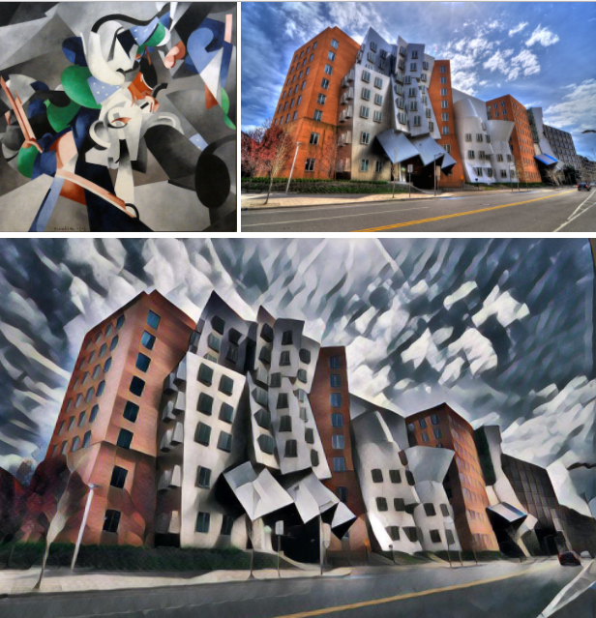
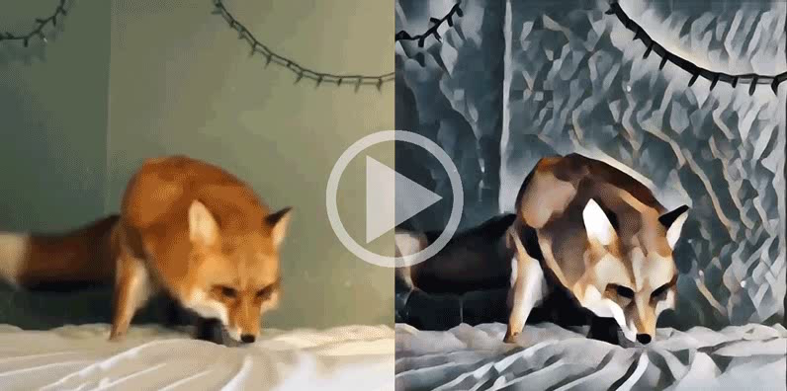
Introduction
Style transfer for video
Style transfer for image

Slide 4
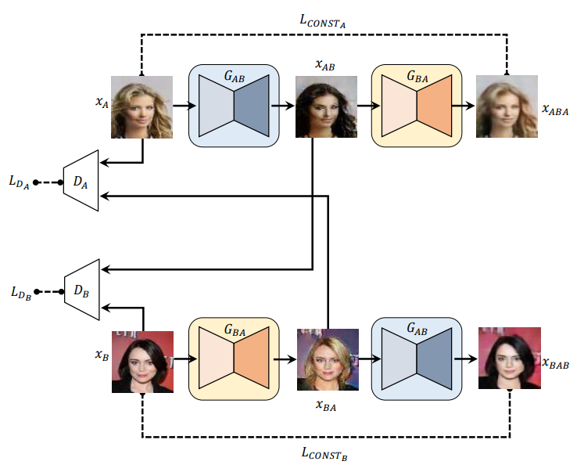
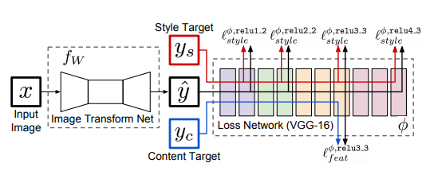
Problem statement
CNN | GAN

Slide 5
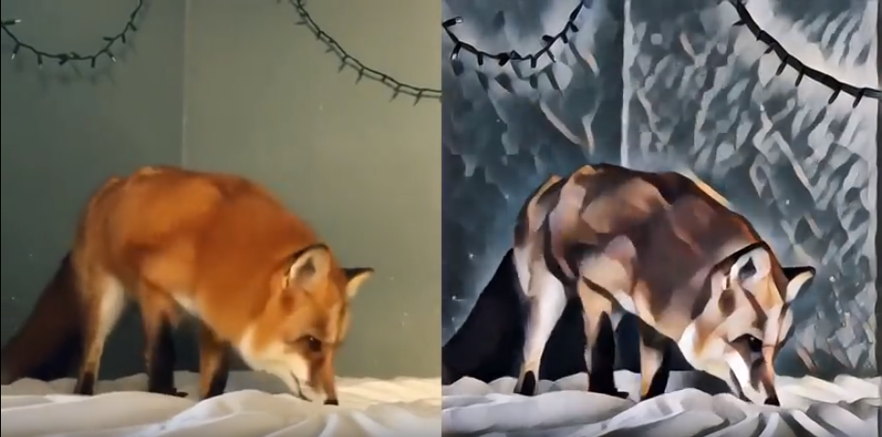
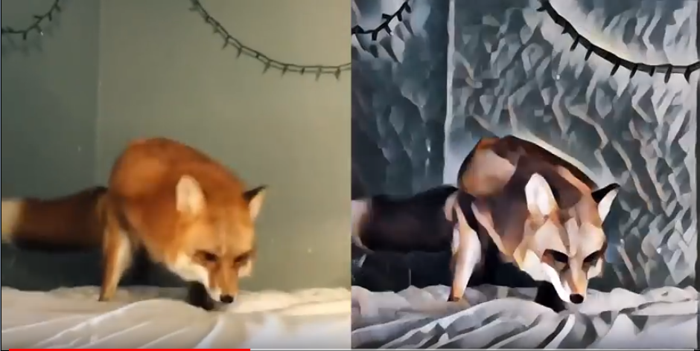
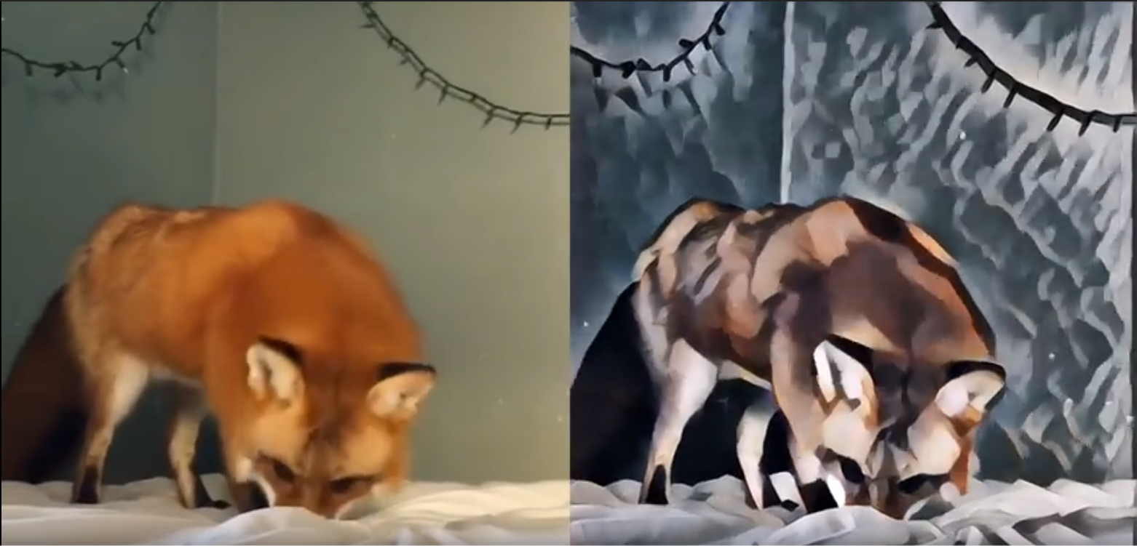
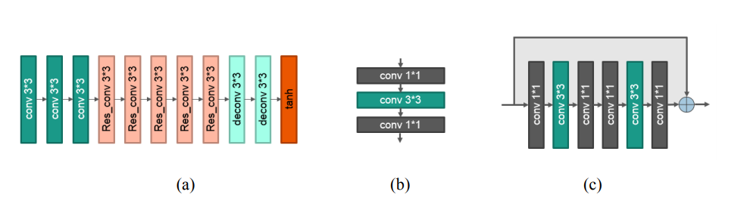
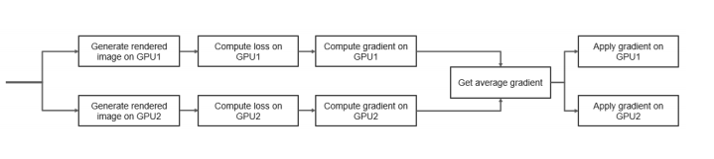
Proposed solution : RAA 3 Steps
Reduce Parameters
Accelerate Training Time
Accelerate Transforming Time
Notes:
Tansforming 缺圖

Slide 6
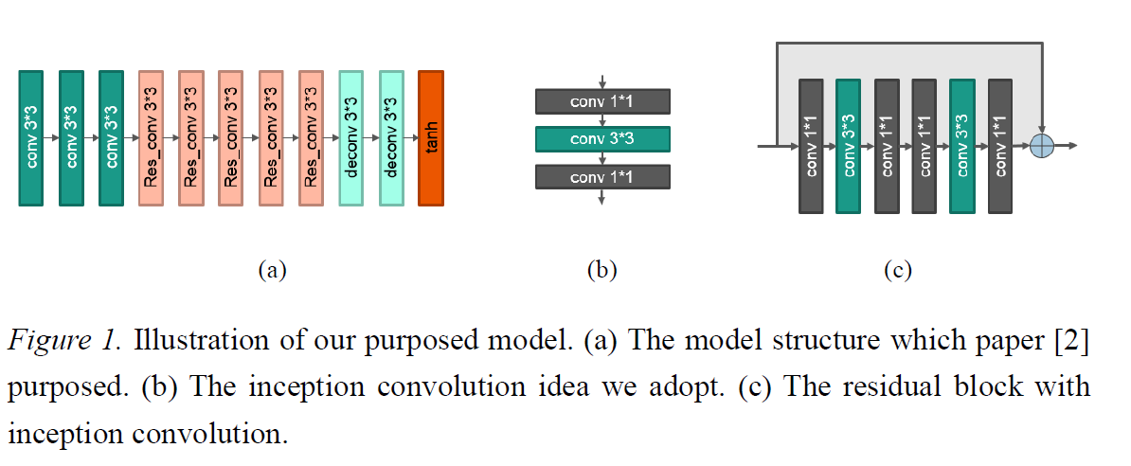
Proposed solution : Reduce Parameters
Use inception idea to render the original model and the residual block
Notes:
Tansforming 缺圖

Slide 7
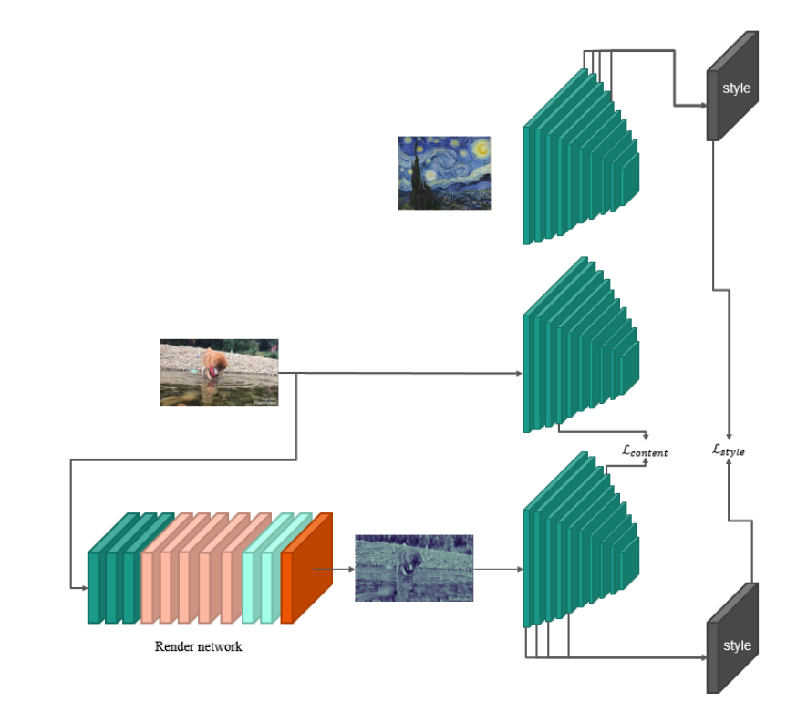
Proposed solution : Reduce Parameters
Change the pretrained model from VGG-19 to tiny-yolo
Notes:
Tansforming 缺圖

Slide 8
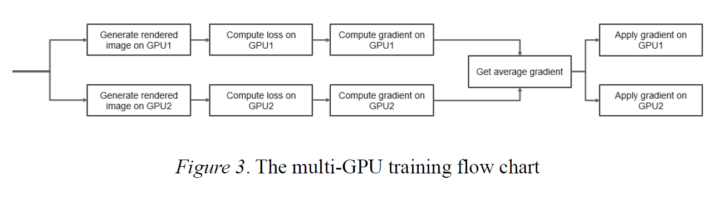
Proposed solution : Accelerate training time
use two GPU to do the acceleration
also use multi-process mechanism to read the image, and store the image into a queue.
Notes:
Tansforming 缺圖

Slide 9
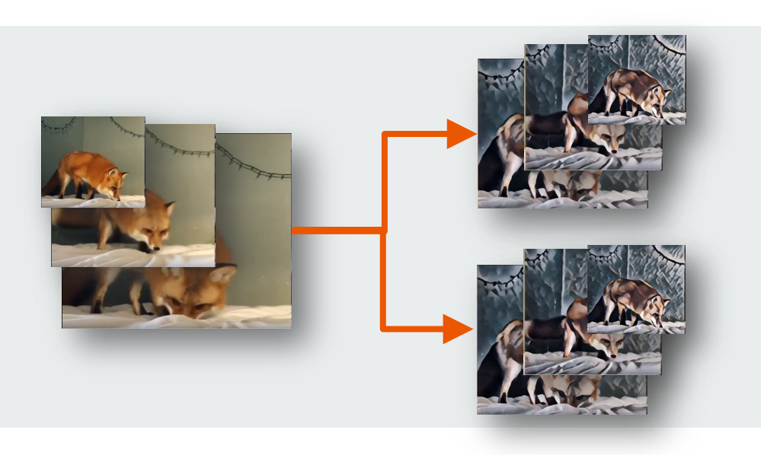
Proposed solution : Accelerate transformation
adopt multi-thread mechanism to drive two GPU doing transformation task
Notes:
Tansforming 缺圖

Slide 10
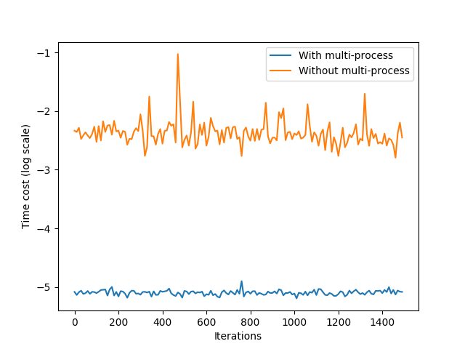
Evaluation

Slide 11
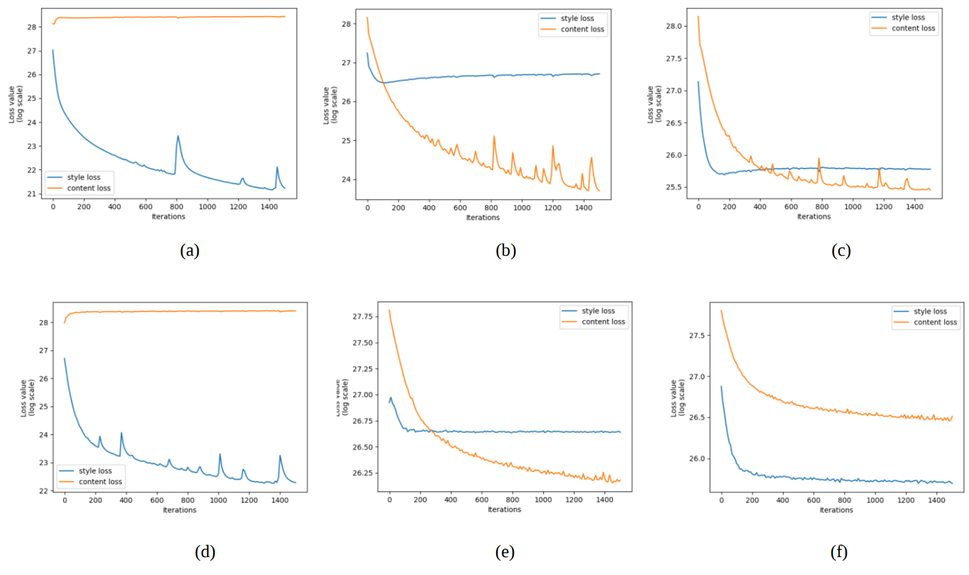
Evaluation

Slide 12
Related work
[1] Leon A. Gatys, Alexander S. Ecker, and Matthias Bethge, “Image Style Transfer Using Convolutional Neural Networks,” In 2016 IEEE Conference on Computer Vision and Pattern Recognition (CVPR), Las Vegas, Nevada, USA, 27-30 June, 2016, pp. 2414-2423.
[2] Dmitry Ulyanov, Andrea Vedaldi, and Victor Lempitsky, “Instance Normalization: The Missing Ingredient for Fast Stylization,” arXiv: 1607.08022v2 [cs.CV], Sep. 2016. [3] Justin Juhnson, Alexandre Alahi, and Li Dei-Dei, “Perceptual Losses for Real-Time Style Transfer and SuperResolution,” arXiv: 1603.08155v1 [cs.CV], March 2016.
[4] Yaniv Taigman, Adam Polyak, and Lior Wolf, “Unsupervised Cross-Domain Image Generation,” In International Conference on Learning Representations (ICLR), Toulon, France, 24-26 April, 2017, pp. 1-15.
[5] Jun-Yan Zhu, Taesung Park, Phillip Isola, and Alexei A. Efros, “Unpaired Image-to-Image Translation using CycleConsistent Adversarial Networks,” In International Conference on Computer Vision (ICCV), Venice, Italy, 22- 29, October, 2017, pp. 2223-2232.
[6] Hang Zhang, and Kristin Dana, “Multi-style Generative Network for Real-time Transfer,” arXiv: 1703.06953v2 [cs.CV], November 2017.

Slide 13
Related work
[7] Yongcheng Jing, Yezhou Yang, Zunlei Feng, Jingwen Ye, and Mingli Song, “Neural Style Transfer: A Review,” arXiv: 1705.04058v1 [cs.CV], May 2017.
[8] Zili Yi, Hao Zhang, Ping Tan, and Minglun Gong, “DualGAN: Unsupervised Dual Learning for Image-toImage Translation,” In International Conference on Computer Vision (ICCV), Venice, Italy, 22-29, October, 2017, pp. 2849-2857.
[9] Taeksoo Kim, Moonsu Cha, Hyunsoo Kim, Jungkwon Lee, and Jiwon Kim, “Learning to Discover Cross-Domain Relations with Generative Adversarial Networks,” In International Conference on Machine Learning (ICML), Sydney, Australia, 6-11, August, 2017, pp. 1857-1865.
[10] Martin Arjovsky, and Leon Bottou, “Towards Principled Methods for Training Generative Adversarial Networks,” In International Conference on Learning Representations (ICLR), Toulon, France, 24-26 April, 2017, pp. 1-17.
[11] Christian Szegedy, Wei Liu, Yangqing Jia, Pierre Sermanet, Scott Reed, Dragomir Anguelov, Dumitru Erhan, Vincent Vanhoucke, and Andrew Rabinovich, “Going Deeper with Convolutions,” In IEEE Conference on Computer Vision and Pattern Recognition (CVPR), Boston, USA, 8-10, June, 2015, pp. 1-9.
[12] Joseph Redmon, Santosh Divvala, Ross Girshick, and Ali Farhadi, “You Only Look Once: Unified, Real-Time Object Detection,” In IEEE Conference on Computer Vision and Pattern Recognition (CVPR), Las Vegas, USA, 2016, pp. 779-788.
[13] Kun He, Yan Wang, and John Hopcroft, “A Powerful Generative Model Using Random Weights for the Deep Image Representation,” In Electronic Proceedings of the Neural Information Processing Systems Conference (NIPS), Barcelona, Spain, 5-10, December, 2016, pp. 1-9.

Slide 14

Conclusion

Slide 15
Conclusion
Using inception idea to reduce parameters
Multithread to read images
Multigpu acceleration
Our proposed method

Slide 16
Conclusion
use random weight VGG-19 to extract the feature like [13], it also perform well
training for more iterations and using more complex loss function may let the result be better
Future Works

Slide 17

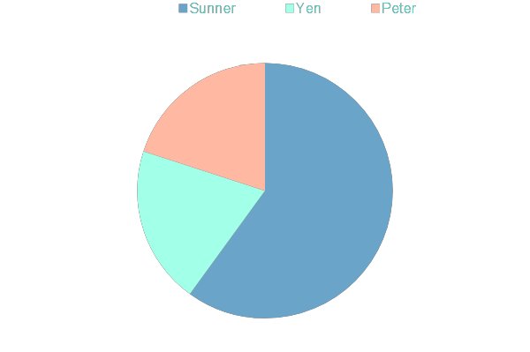
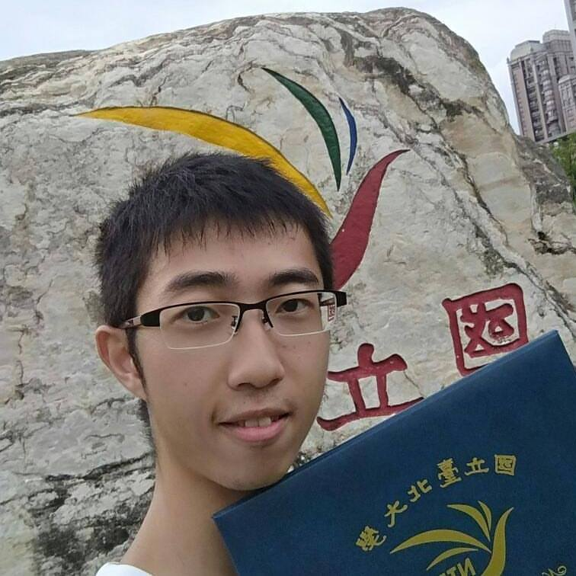
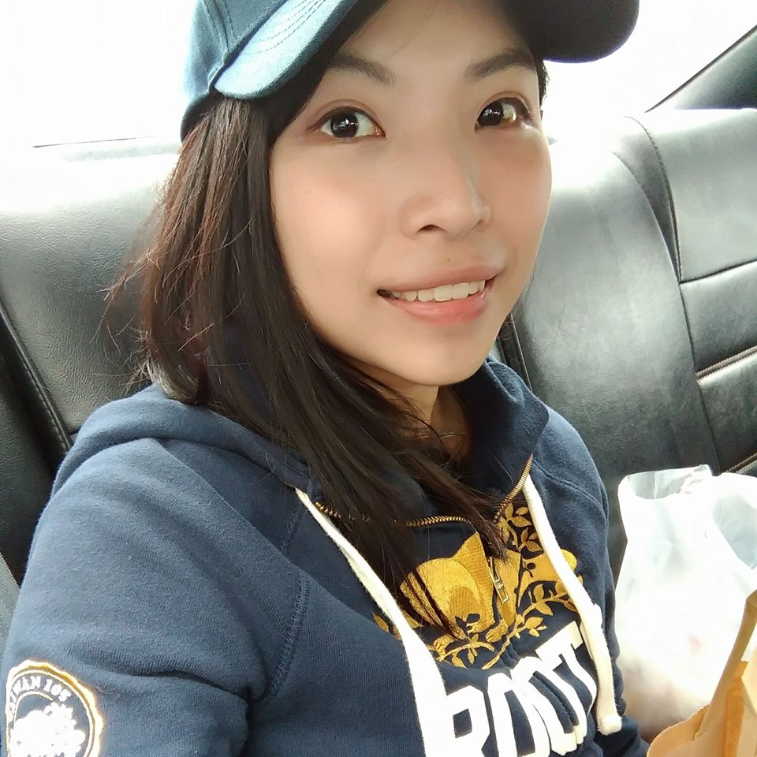

Contributions of each member

Slide 18
Q&A

